Slide 1

Terna Engineering College Computer Engineering Department Mini Project 1A Review I Voice and Text Summary Generation using ML and NLP
By
Aditya Singh TU3F1819005
Prathamesh Chaskar TU3F1819006
Shruti Rathod TU3F1819029
Under the Guidance of : Dr. Mire Archana Vasant

Slide 2
Presentation Outline
Abstract
Introduction
Literature Survey
Problem Statement
Objectives
Scope
Methodology
Progress Diagram
Tools and Dataset
Expected Outcome
References

Slide 3
Abstract
Text summarization is a subdomain of Natural Language Processing (NLP) that deals with extracting summaries from huge chunks of texts. It is a process of generating a concise and meaningful summary of text from multiple text resources such as books, news articles, blog posts, research papers and emails or more. Machine learning algorithms can be trained to comprehend documents and identify the sections that convey important facts and information before producing the required summarized texts. This project uses machine learning and NLP to generate condensed form of the text and also give you the entities that was in the provided input.

Slide 4
Introduction
Automatic text processing is a research field that is currently extremely active. One important task in this field is automatic summarization, which consists of reducing the size of a text while preserving its information content. A summarizer is a system that produces a condensed representation of its input’s for user consumption.
The type of NLP approach we are using is called Extraction-based approach. In this approach a subset of words that represent the most important points is pulled from a piece of text and combined to make a summary. The dataset we will be using consists huge text samples with valid sources.
These extracted features are of two kinds: statistical – based on the frequency of some elements in the text; and linguistic – extracted from a simplified argumentative structure of the text.

Slide 5
Literature Survey
No. | Paper Title | Year Published | Development and Findings
1 | A SURVEY AUTOMATIC TEXT SUMMARIZATION | 2017 | Text summarisation based on query generic approach and Neural Networks Based. . A neural network is trained on a corpus of articles. The neural network is then modified, through fusion to produce a summary of the most ranked sentences of the article. Through feature fusion, the network discovers the importance of various features used to determine the Summary-worthiness of each sentence.
2 | GloVe: Global Vectors for Word Representation | 2014 | The statistics of word occurrences in a corpus is the primary source of information available to all unsupervised methods for learning word representations, and although many such methods now exist.
3 | Named Entity Recognition | 2011 | NER systems have been created that use linguistic grammar-based techniques as well as statistical models such as machine learning. Hand-crafted grammar-based systems typically obtain better precision.

Slide 6
Problem Statement
To develop a program that automates the human process of summary generation using the required tools and programming languages needed. The generation of summary can have the output in text and audio format. The program must also identify and list the different entities discussed in the input like person, time, currency, organization, etc.

Slide 7
Objectives
Automation of summary generation
Output summary in text and audio format.
Train and customize the model for Named Entity recognition.
Generate and list the multiple named entities in the discussed input.
Store the summary generated using file systems.

Slide 8
Scope
This project of automating the summary generation process can be used in multiple scenarios where a single person is giving the input to the program.
The project can evaluate summaries for scenarios like a person giving speech, single commentary for a sports event, news channel reports, blogs, newspaper articles, Wikipedia articles, etc.
It can give the information about the entities present in the input. Entities such as name, locations, organizations, time, currency, number etc. It can be used to evaluate research papers and resumes of candidates to get important information in one place.

Slide 9
Methodology
We are using punkt for tokenizing the text into a list of sentences. It uses an unsupervised algorithm to build a model for words and sentences. Then we do text processing to filter the stop words. GloVe an unsupervised learning algorithm is used for obtaining vector representations of words. Then using cosine similarity for vectors we create rankings from networkx python module, used for determining patterns.
Then we determine the Named Entity in the text, which identifies the entities discussed in the text and classifying them into categories like Person, Organization, Location, etc. We are using the SpaCy library to train the NER models according to our requirements. We use our dataset of multiple text examples to train the NER model. Using these pipelines and models we make a custom Named Entity Recognizer for identifying the entities like in blogs, articles, notes, research papers etc.
The existing NER model has some flaws in identifying the entities. So we train our own NER model with a dataset consisting of over 200 text samples. We randomize the order of training data for every iteration so NER doesn’t generalize the outcome.

Slide 10
Text File
Similarity Matrix
Sentence Segmentation
Networkx Graph
Sentence Tokenization
Local Word Score
Stop Word Removal
Total Sentence Score
Vectorizing
Sentence Extraction
Summary Document

Slide 11
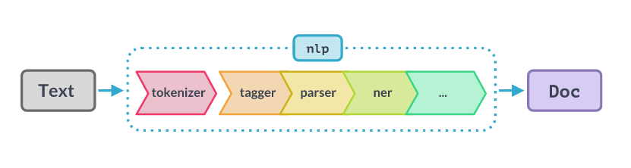
Progress Diagram
This is the visualization of the process to generate Named Entity from an input of text given to the program. The tokenizer, tagger and parser segments the text and the trained NER extracts the entities discussed in the input text.

Slide 12
Tools and Datasets
We will use the following tools:
Python Programming Language
NLTK
Scikit-learn
GloVe- Unsupervised Learning Algorithm
spaCy library
Training Dataset – 200 text and resumes for training the model for Named Entity recognition.

Slide 13
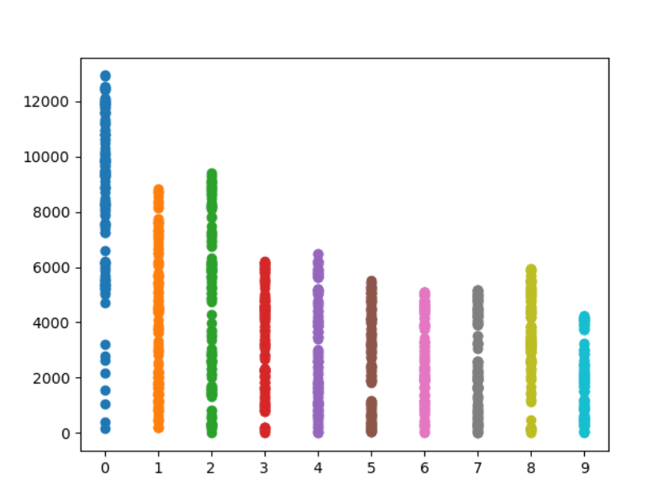
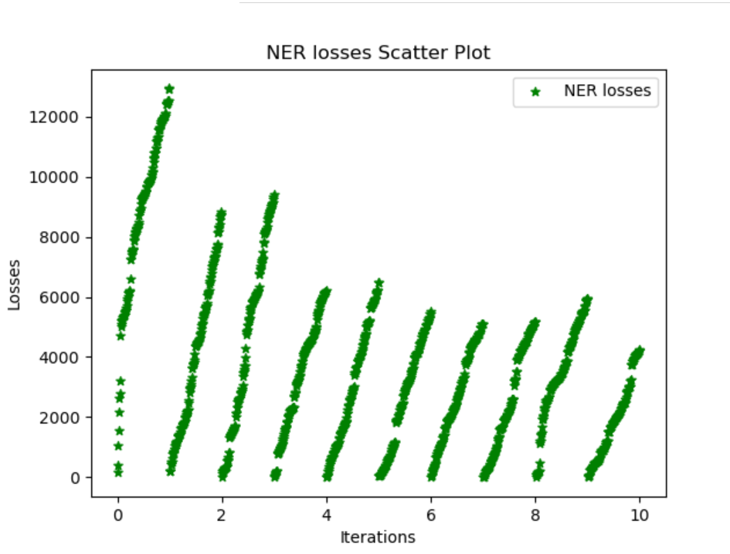
Training Output

Slide 14
Expected Outcome
The outcome is a text file which includes the summary of the input given to the program. The output can consist of the following
The condensed version of the complete input given to the program.
The entities which are used in the input also listed in a file.

Slide 15
References
1) A Survey Automatic Text Summarization, http://pressacademia.org/archives/pap/v5/29.pdf
GloVe, https://www.aclweb.org/anthology/D14-1162.pdf
NER, https://www.aclweb.org/anthology/D11-1141.pdf
SpaCy Language Processing, https://spacy.io/usage/processing-pipelines

